Slide 1
Exploring QUIC Security and Privacy
A Comprehensive Survey on QUIC Security and Privacy Vulnerabilities, Threats, Attacks, and Future Research Directions

Slide 2
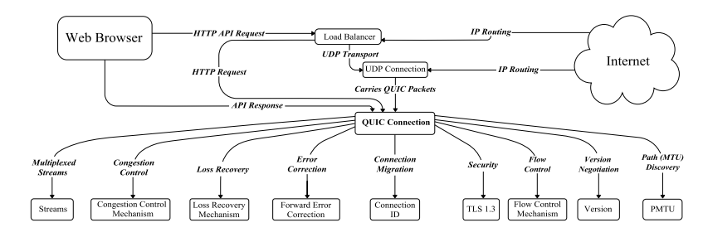
PMTU (packet size maximally , send probes to try and check the maximum size)
The load balancer serves as a single-entry point, terminating the connection (TLS/QUIC encryption, for example) from the client.
Application-Level (L7 app) Routing Acting as a reverse proxy, it can then inspect or modify the request (URL rewriting, header insertion, access control, etc.) before relaying it to one of the backend servers.
Load Distribution The same component decides which server (or group of servers) should receive the request, optimizing resource usage and ensuring high availability.

Slide 3
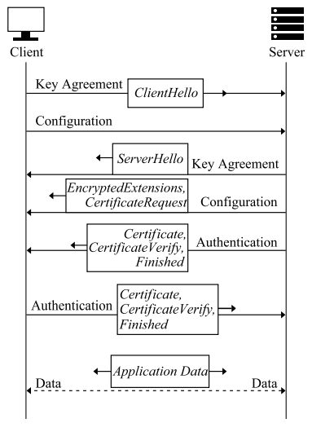
QUIC handshake starts with the client initiating the process by sending a “ClientHello” message to the server. Afterward, both parties engage in a key agreement to determine an encryption key. They then configure their connection settings. As the handshake continues, encrypted extensions are employed to strengthen security. The server can request the client’s certificate for authentication via a “CertificateRequest.” In response, the client sends its certificate for verification. The server then confirms the client’s certificate in a step named “CertificateVerify.” Once these procedures are finalized, the handshake process is marked complete with a “Finished” message. The server acknowledges the handshake initiation by replying with a “ServerHello” message. After the successful conclusion of the handshake, both the client and server are preparing to exchange application data securely
1-RTT

Slide 4
SIGNIFICANT SECURITY AND PRIVACY VULNERABILITIES IN QUIC
0-RTT Resumption Weakness : vulnerability that allows replay attacks , attackers can duplicate transactions or gain unauthorized access to sensitive information.
Amplification Vulnerabilities : Attackers use UDP’s efficiency to amplify the volume of traffic directed at a victim, turning benign servers into tools for largescale denial of service attacks
Crypto-Related Issues : One of the main reasons for crypto-related issues in QUIC is that implementation errors can arise from improper configuration of encryption protocols or using default keys
Header Encryption Limitations : leaves some parts of the headers unencrypted to facilitate routing , it introduces the risk of metadata leakage , can potentially allow attackers to conduct traffic analysis (WFP)
Version Negotiation Integrity : This flaw potentially allows attackers to intervene in the negotiation process, forcing the communication to downgrade to a less secure version of the QUIC protocol
Path Migration Vulnerabilities : Attackers exploiting these vulnerabilities can redirect traffic to servers under their control or manipulate the path to degrade the connection quality because it allows connections between different IP addresses and maintain connection during IP change
Various vulnerabilities within the QUIC protocol that can potentially be exploited by attackers. These vulnerabilities represent possible attack vectors against QUIC.

Slide 5
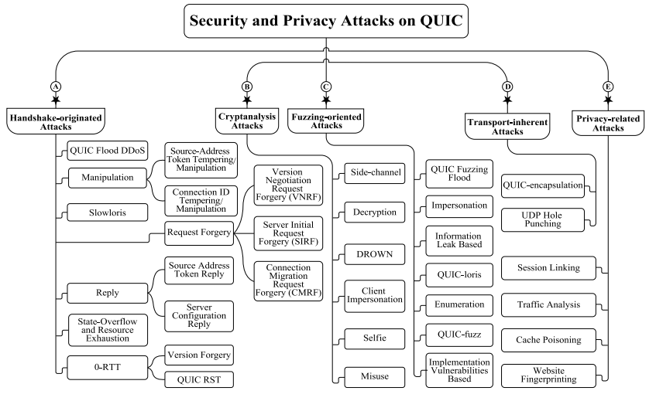
CRITICAL SECURITY AND PRIVACY ATTACKS ON QUIC
Handshake-originated attacks
Cryptanalysis attacks
Fuzzing-oriented attacks
Transport-inherent attacks
Privacy-related attacks

Slide 6
MITIGATION STRATEGIES OF QUIC
TLS 1.3 Handshake Security Concerns
ClientHello (CHLO) Over UDP: Enables secure communication but exposes Server Name Identification (SNI) details.
Metadata Leakage: Vulnerable during initial unencrypted packet exchange, allowing eavesdroppers to gather significant metadata.
Encrypted Client Hello (ECH)
Enhanced Privacy: Encrypts all CHLO information, including server name and pre-shared keys, addressing privacy gaps in TLS 1.3 and ESNI.
Security Benefits: Ensures confidentiality, authenticity, and protection against downgrade attacks.
Limitations: Ineffective against traffic analysis attacks; further improvements needed to mitigate metadata leakage.
Advanced Privacy Technologies
Oblivious HTTP & MASQUE:
Private Relay: Utilizes multiple proxy servers to obscure users’ IP addresses and browsing histories through multi-hop IP packet proxying.
Oblivious HTTP: Encrypts HTTP messages via trusted relays, concealing both client IP addresses and message content from the relay.
Addressing TLS Vulnerabilities
Potential Threats: Side-channel attacks and quantum computing threats are inherent to TLS implementations.
Mitigation Strategies:
Secure Implementations: Use leak-proof TLS implementations to prevent side-channel leaks.
Algorithm Agility: Negotiate robust, future-proof cryptographic algorithms to defend against emerging threats.
QUIC’s Encryption: Utilizes AES128 GCM and SHA256 for initial handshakes, minimizing unique risks due to the public nature of the handshake key.

Slide 7
POTENTIAL FUTURE RESEARCH DIRECTIONS
DDoS Attacks
Website Fingerprinting Attacks Against QUIC
Post-Quantum Cryptography in QUIC
QUIC Privacy Oversight
Problem Definition
State-of-the-Art Solutions
Remaining Challenges

